Slide 1
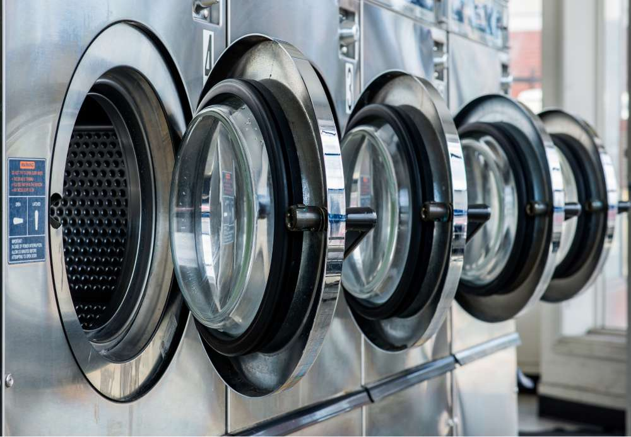
Cash your laundry...
And optimize its performance...
1

Slide 2



Optimize your laundry on 3 different levels:
Improved ergonomic and automated credit management
Consumption and energy control
Easy to start and remotely controllable
2

Slide 3

The benefits
Better monitoring of equipment usage
Reduction of unnecessary consumption
Intended for individuals and professionals
Real-time credit monitoring from a web interface
Compatible with all washing machines and dryers
Avoids fraud and misuse of machines
Better energy strategies for machines
3

Slide 4
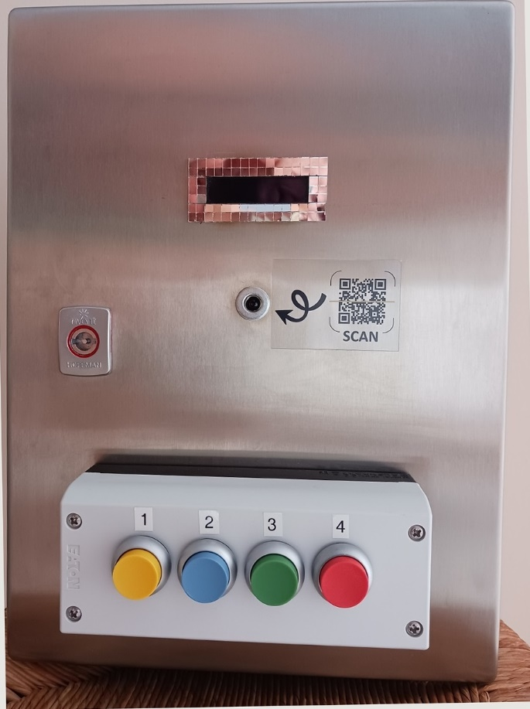
Why this coin mechanism?
This connected coin recycler aims to modernize and secure access to the laundromat thanks to a cardless digital system, based on personalized QR codes. It will ensure reliable control of user rights per dwelling/person, simplify management for the manager in charge of the laundromat via an online interface and improve the user experience with a practical, fair system adapted to current needs. The system also incorporates an intelligent magnetic field function that automatically cuts off power to unused machines, thus contributing to energy savings and better control of costs related to electricity consumption.
4

Slide 5
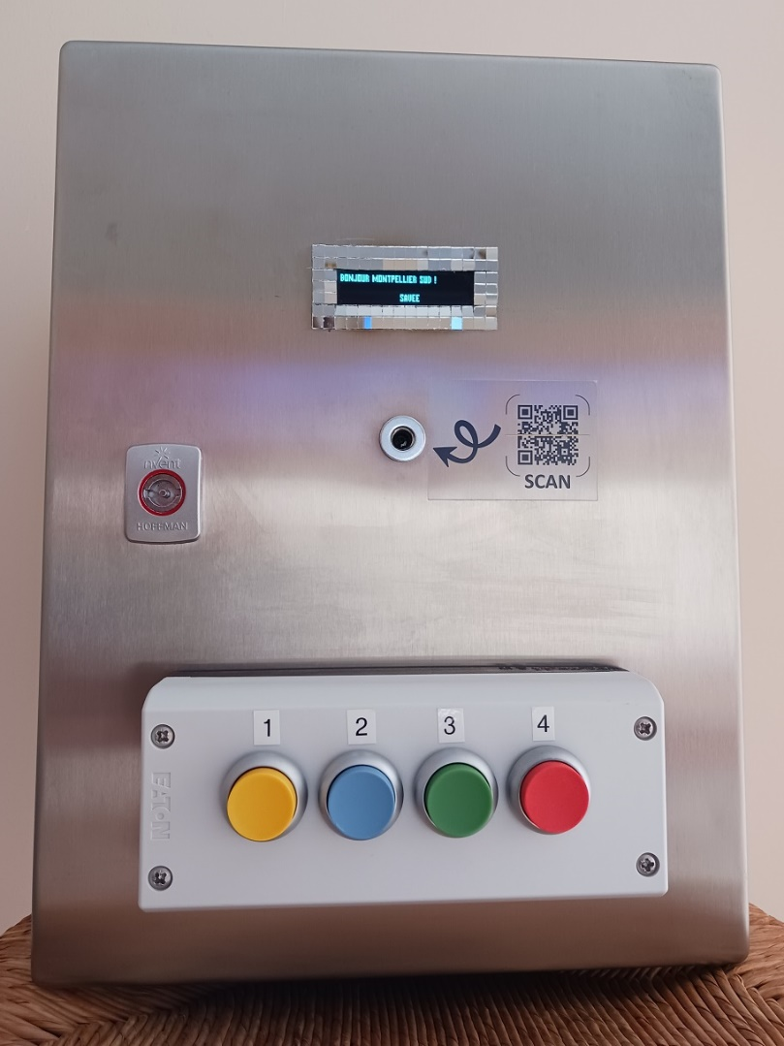
QR Code Coin Mechanism:
Illuminated LCD display
QR Code Reader
Machine selection buttons
6

Slide 6
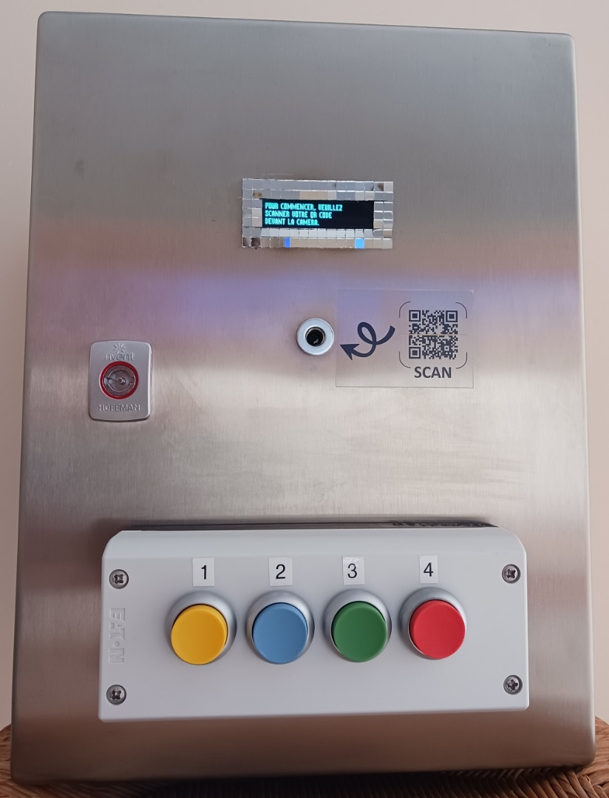
Step 1
The user scans his QR Code via his phone or a sheet of paper in front of the camera.
The coin recycler analyzes and searches for the validity of the QR Code.
7

Slide 7
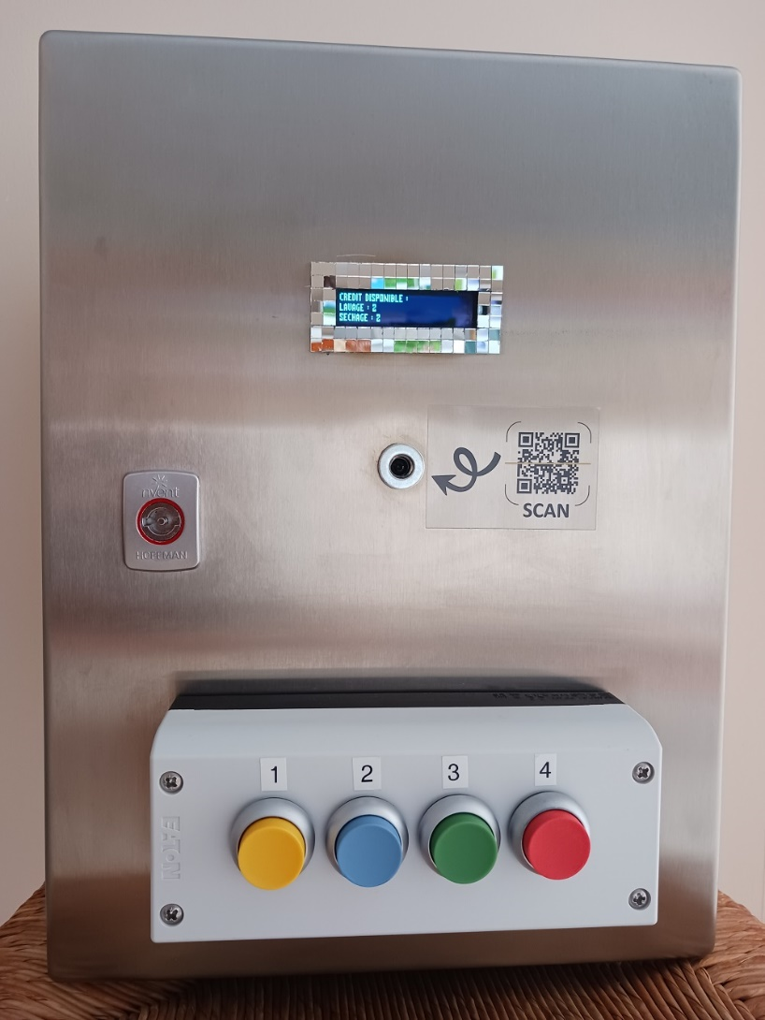
Step 2
The QR Code has been recognized, the software updates the number of credits if necessary in the database and then the screen displays the number of available credits.
The user chooses the number of the machine to be used.
8

Slide 8
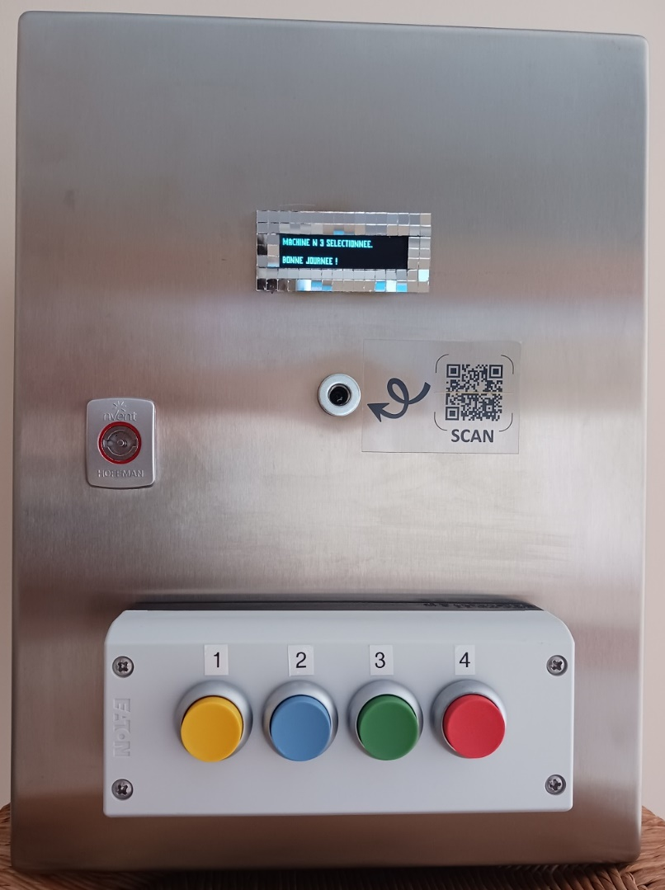
Step 3
Machine N°3 is selected, the coin recycler debits the credit, updates the online database and returns to his home screen.
9

Slide 9
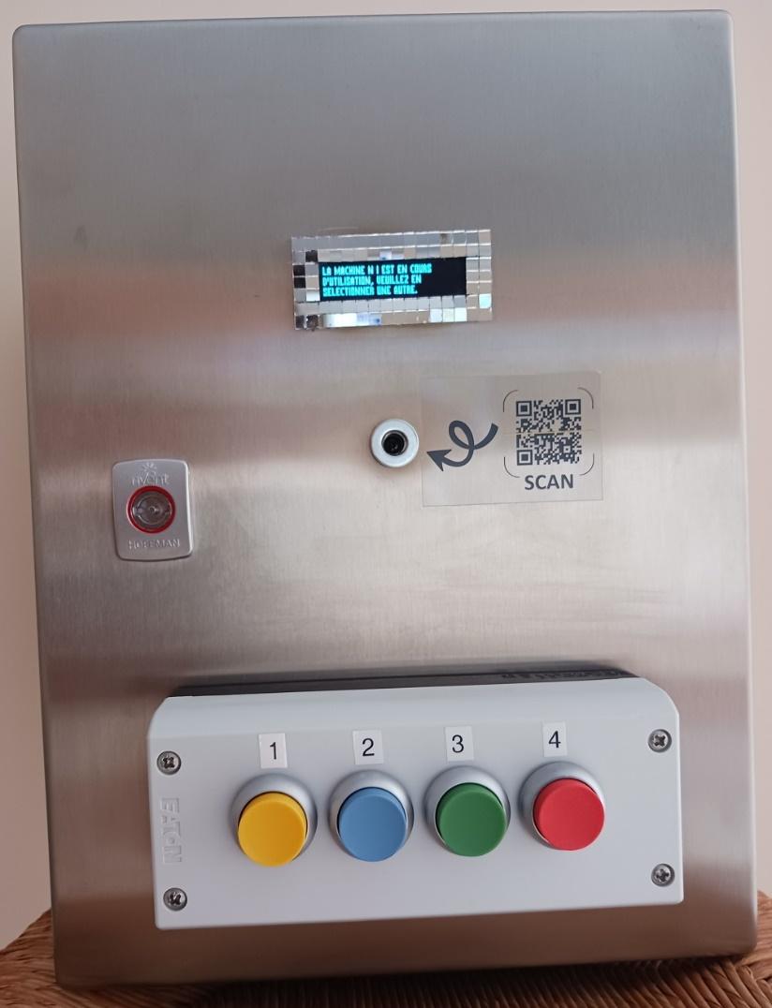
Detection
If the user selects a machine that is already in use, the coin recycler detects it and displays it by asking to select another machine without having debited the previous selection.
If the user does not select anything, the system cancels and returns to the main screen.
10

Slide 10
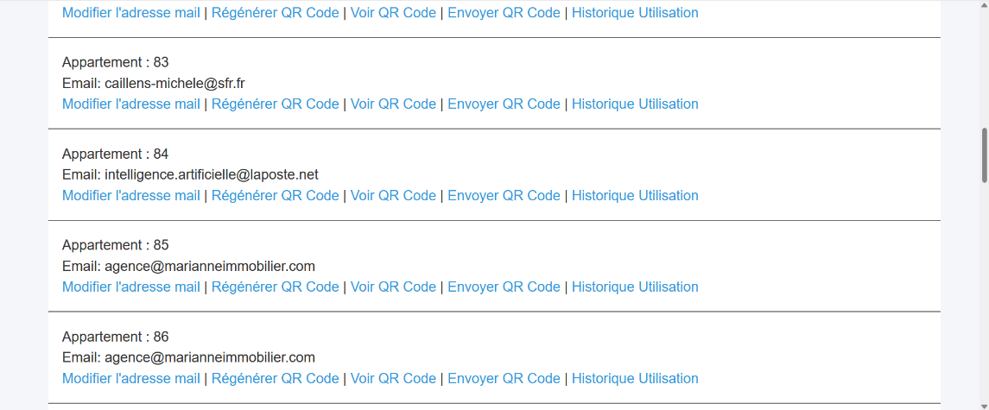
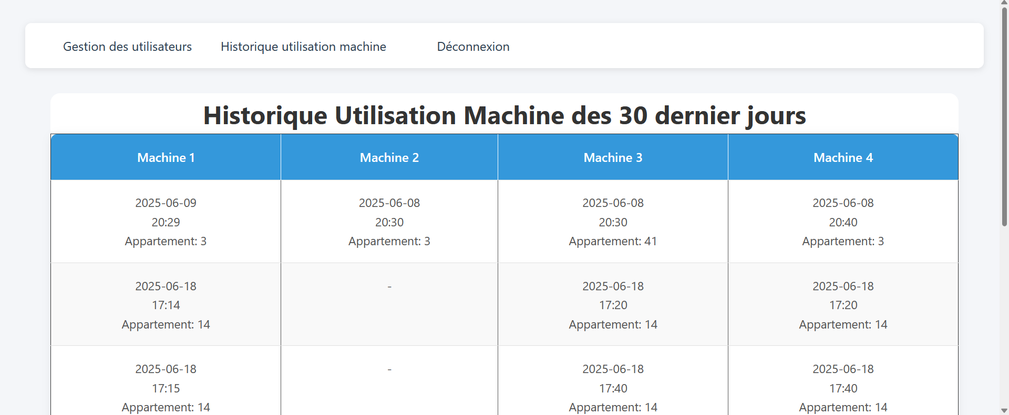
Online Interface
A web-based administration console to manage QR Codes, users, machine history, etc.
11

Slide 11

Deployment and support:
Simple installation: The machines are connected directly to the coin mechanism without the need for a dry contact or a specific electronic card.
Administration console: The coin recycler is connected to the Internet allowing him to retrieve the available credits when a QR Code is detected.
Easy to use: explanation of the web interface, creation of QR codes, credit tracking. Remote or on-site technical support, regular software updates, dedicated hotline.
12

Slide 12
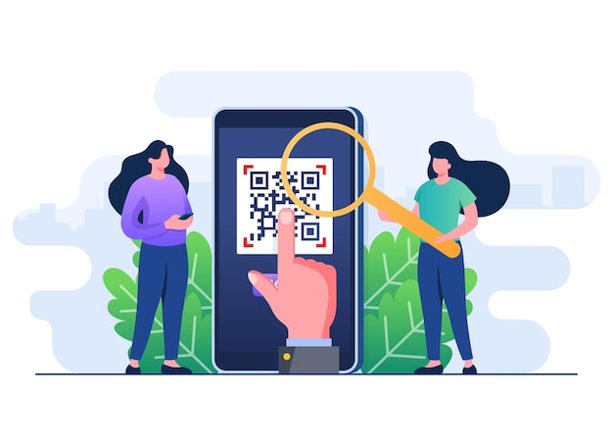
Prospects for development
Possibility of adding future functions: NFC, online payment, detailed statistics of use, consumption, extension to other public services (rooms, car parks, etc.)
13

Slide 13
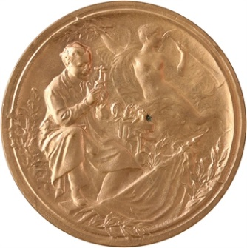
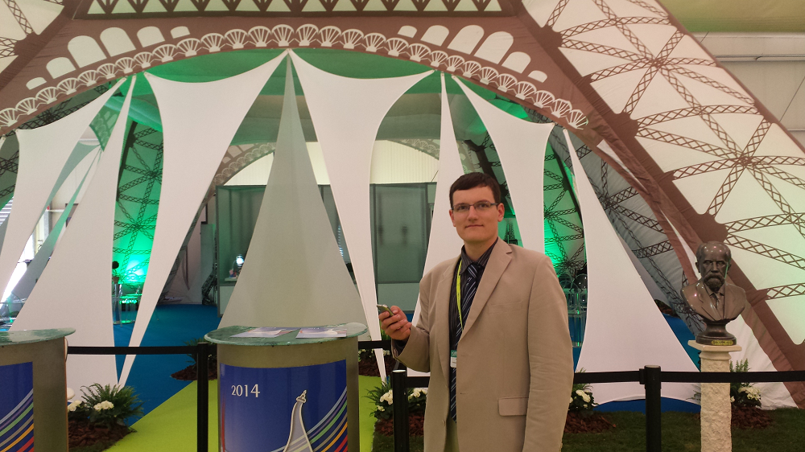
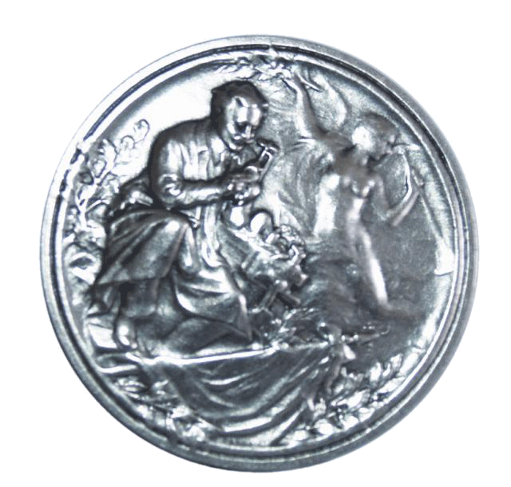
Contests won by Savee
Gold Medal at the Lépine Regional Competition in Monts en Touraine (2011)
Silver Medal at the European Lépine Competition in Strasbourg (2014)
14

Slide 14


Contact
Alexander Hoffmann
Director
+33 (0)6 11 30 11 61
info@lifee.ai
SAVEE
20 rue famille Carrausse
34300 AGDE – France
https://www.lifee.ai
15

