Slide 1
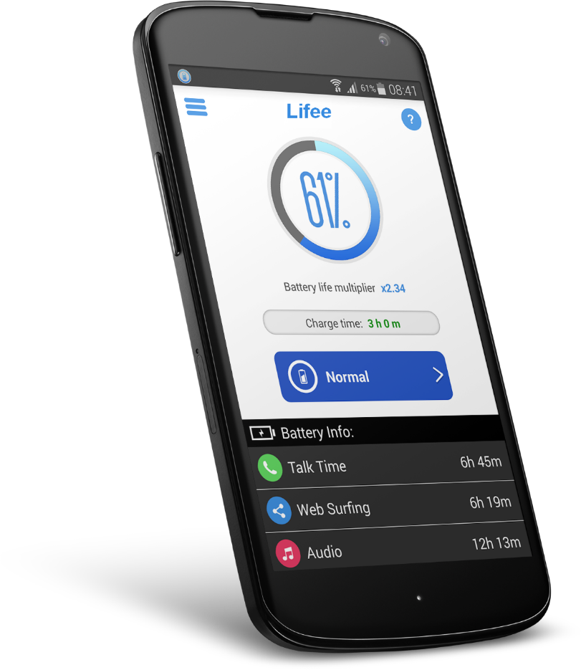
Double the battery life...
And optimize its performance...
1

Slide 2



Optimize your mobile on 3 different levels:
Energy: extended autonomy
Time saving: more efficiency on your phone/tablet/glasses
Hardware: Extends the life of your phone/tablet/glasses
2

Slide 3
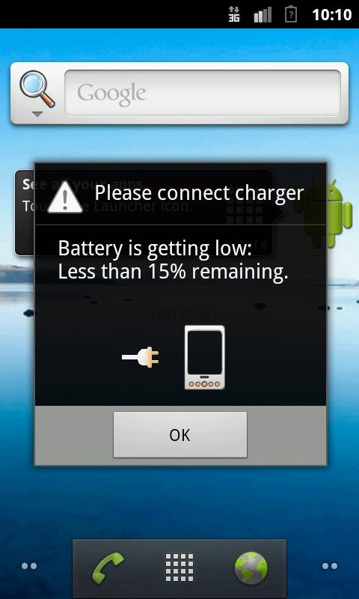
Result
The power of phones continues to multiply and the battery life decreases.
*Source: Gartner
3

Slide 4
Why Lifee?
This app is not just a simple control panel to turn WiFi, Bluetooth, etc. on or off. It's a smart energy manager with advanced features!
Some main customizable functions:
- Pocket Standby: Once your phone is put away, Lifee puts it to sleep.
- Release of excess memory consumption of applications.
- Disables WiFi when the screen turns off and during a call.
- Night mode: puts the phone into a deep sleep without turning it off.
- Display of the necessary battery recharge time.
- Manual or automatic phone power adjustment.
- Complete diagnostics on the working status of your device.
4

Slide 5

The benefits
Doubles the battery life of a phone or tablet
Affordable price for any user
Intended for individuals and professionals
A real need for consumers
A market for Android phones and tablets
Highly cost-effective without a large investment
Better energy strategies for mobile
5

Slide 6



Quality = Priority
No ads, no spam, no viruses, 100% green development
6

Slide 7
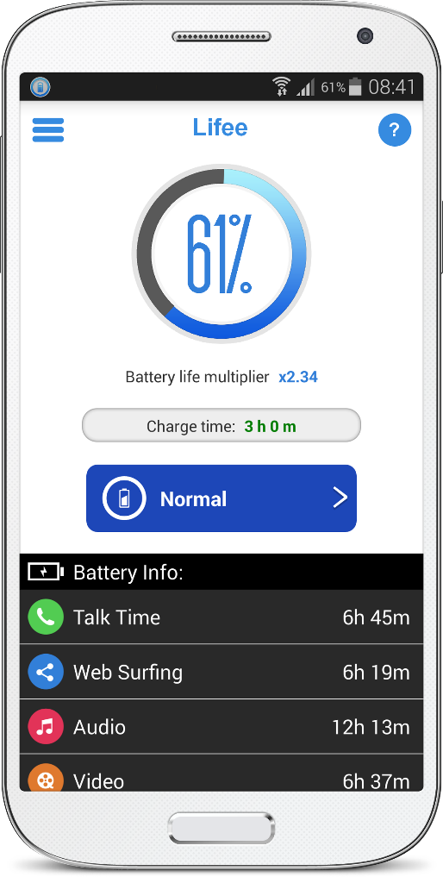
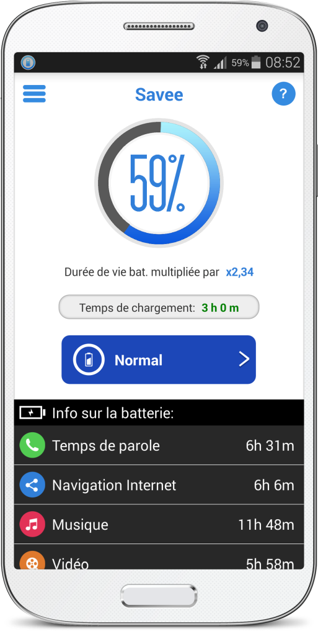
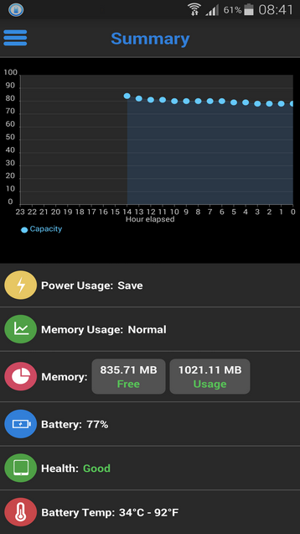

Quick view of remaining range information
Energy policy choices
Detailed report
Explanatory
Animated
Configurable
7

Slide 8
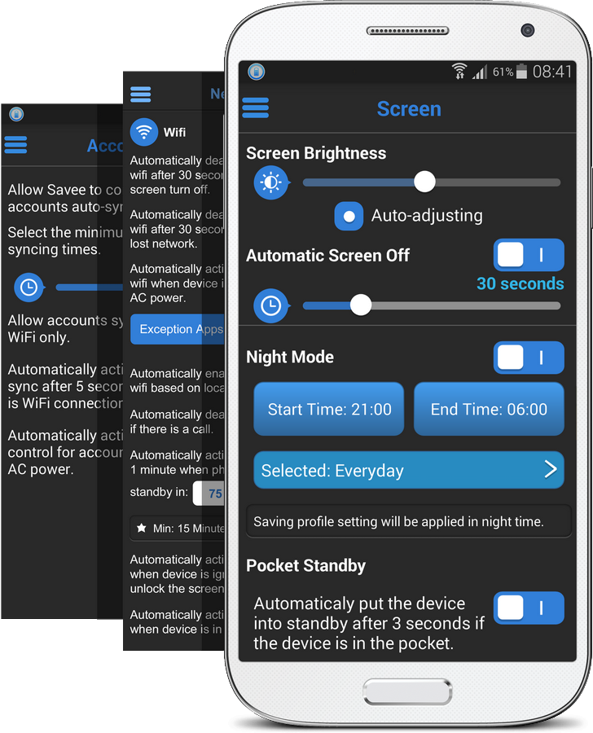
Energy Strategy
Double the battery life of your phone with Lifee.
A simplified user interface with many settings on wifi, bluetooth, standby, night status, location, account synchronization... You can set the saving mode that works best for you.
8

Slide 9
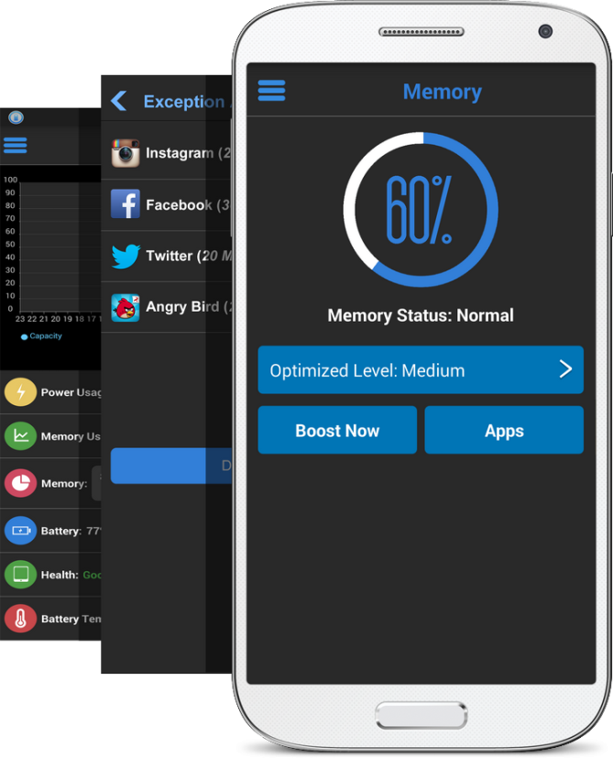
Memory cleaner
The more demanding the applications, the more the phone will slow down and consume. Lifee lets you choose to manage and optimize the memory of applications with 3 different modes.
This allows you to save memory space to speed up your phone to make it run smoother in its tasks.
9

Slide 10
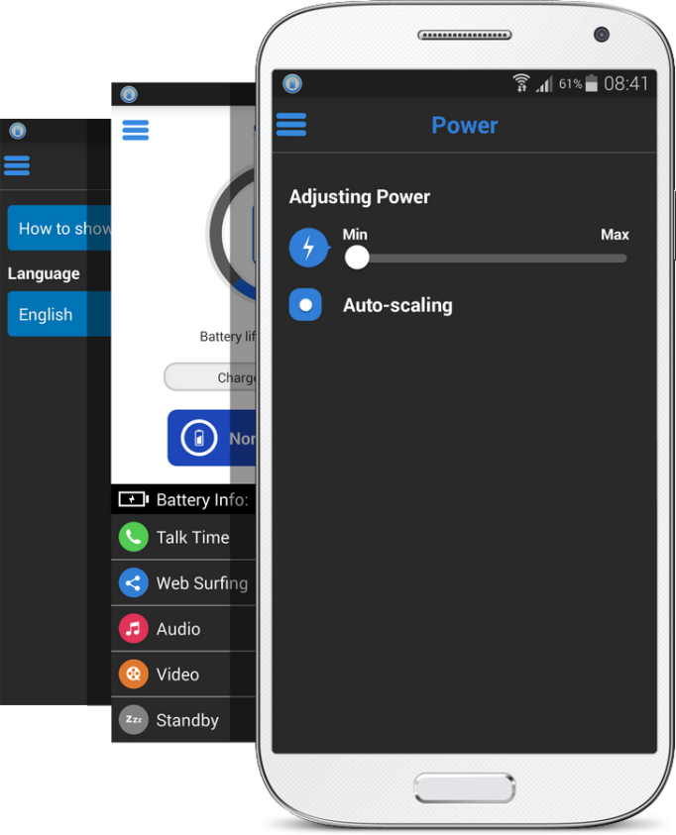
Power Manager
Your phone doesn't need to run at full power constantly, which is why Lifee analyzes consumption in real time and automatically adjusts it.
This allows you to fine-tune the energy saving according to your needs.
10

Slide 11
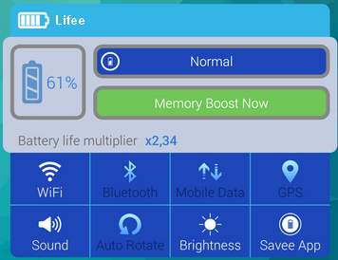
Widget on the screen
Lifee has a widget that can be placed on the phone's home screen.
This widget brings together the most common features of Lifee. You can optimize the phone's memory with just 1 click by pressing the appropriate green button. You can choose the mode of consumption of the phone (Powerful, Normal, Economical).
11

Slide 12
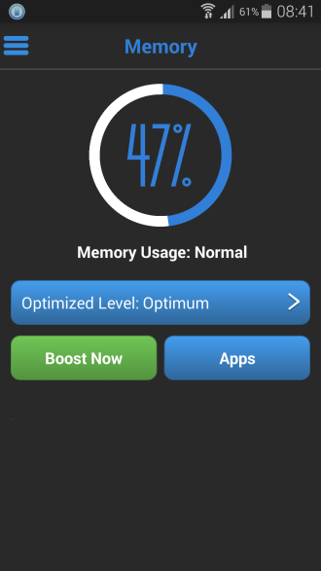
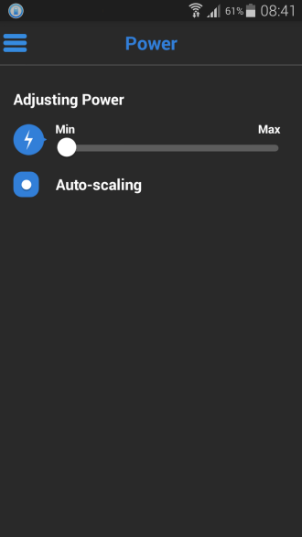
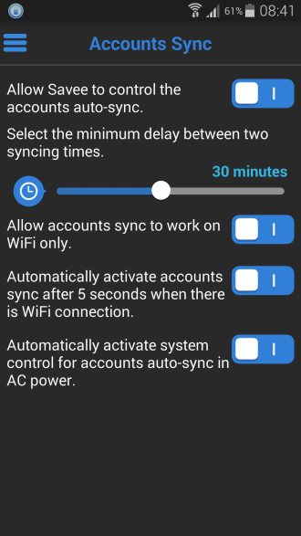
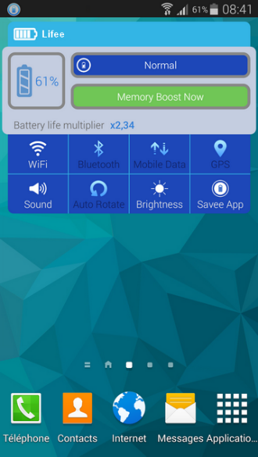
Maximum savings
Memory management, intelligent power regulation, real-time synchronization with applications, widget on the home screen...
12

Slide 13
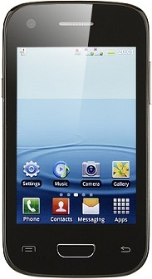
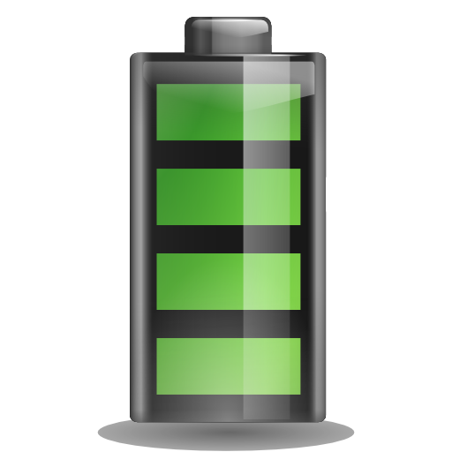

Result
+
=
x2
13

Slide 14

Remote Control
By using ZigBee technology, combined with the IEEE 802.15.4 standard, Lifee helps you intelligently manage your energy strategies across all your electronic devices:
- Lights
- Shutters
- Thermostats
- Alarms
- Water and gas consumption
- Screens
- Etc…
Lifee allows you to control all devices remotely to manage energy savings easily with your finger and voice recognition.
15

Slide 15
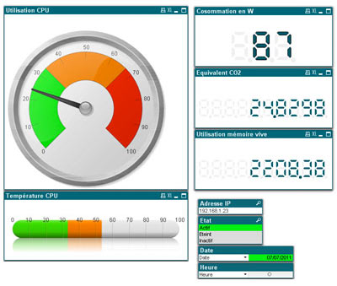
Energy Report
Lifee offers a remote reading solution that provides detailed reports on device consumption and savings.
16

Slide 16




Business Customers
"After 10 days of testing the Lifee app, we have effectively doubled the battery life of our smartphones."
Florence Barbi - Head of the ASC SI / IS ASC Pole Manager
17

Slide 17


Competition
Silver Medal at the European Lépine Competition in Strasbourg (2014)
18

Slide 18
User Reviews
Tân Nguyễn September 23, 2014
Good app This is good app to save my battery. Normally, my phone just can use in 1-2 days but with this app, I can use it even in 3 days.
An Le TT September 21, 2014
Great app to extend battery life for Android phone.
Kevin B. September 29, 2014
Awesome This app help my device is long life than normal. It's awesome!
Thuy Nguyen September 21, 2014
Very good app. It's easy to use and useful to me.
Bui Tan Loc September 19, 2014
Loc Bui Perfect app with nice GUI. This app is what I want to save battery and have quick commands to control and custom proflies for my specific needs. It works well on my Google Nexus 5.
TIM TIM September 18, 2014
Very great apps This is really a great battery saver app I ever used. Recommend you to use this app to save your battery!
Quoc Lam September 14, 2014
Love it. This makes my phone lasts longer. Also, many handy rules to fit my specific needs
More than 3 500 happy users!
Now available:
18

Slide 19
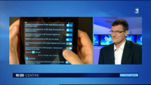







Press/TV
(click to view)
(click to view)
19

Slide 20


Partners
CPUID.com is our technology partner. We use CPU-Z for Android to test the power adjustment.
Intel is our technology partner. Lifee has been successfully tested by their technical teams on Intel x86 processors running Android.
20

Slide 21


Contact
Alexander Hoffmann
Director +33 (0)6 11 30 11 61
info@lifee.ai
Lifee
20 rue famille Carrausse
34300 AGDE – France
https://www.lifee.ai
21

