Slide 1

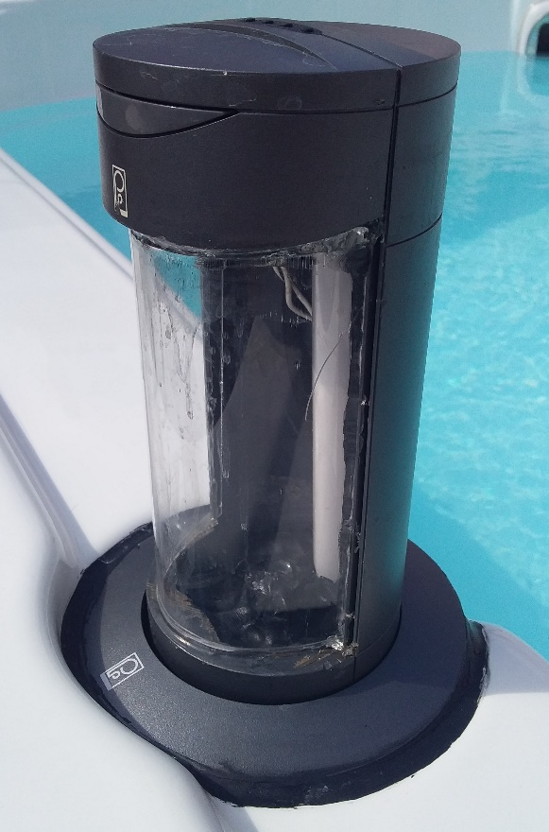
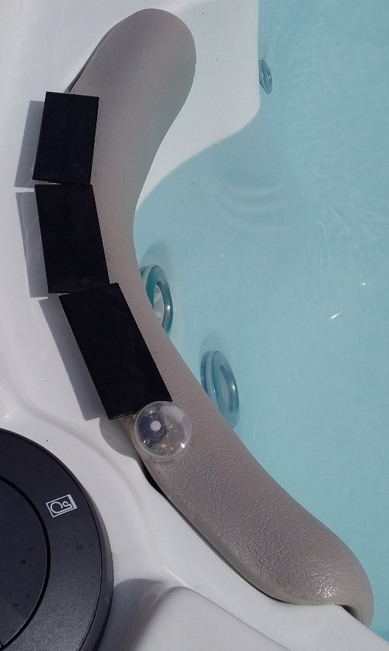
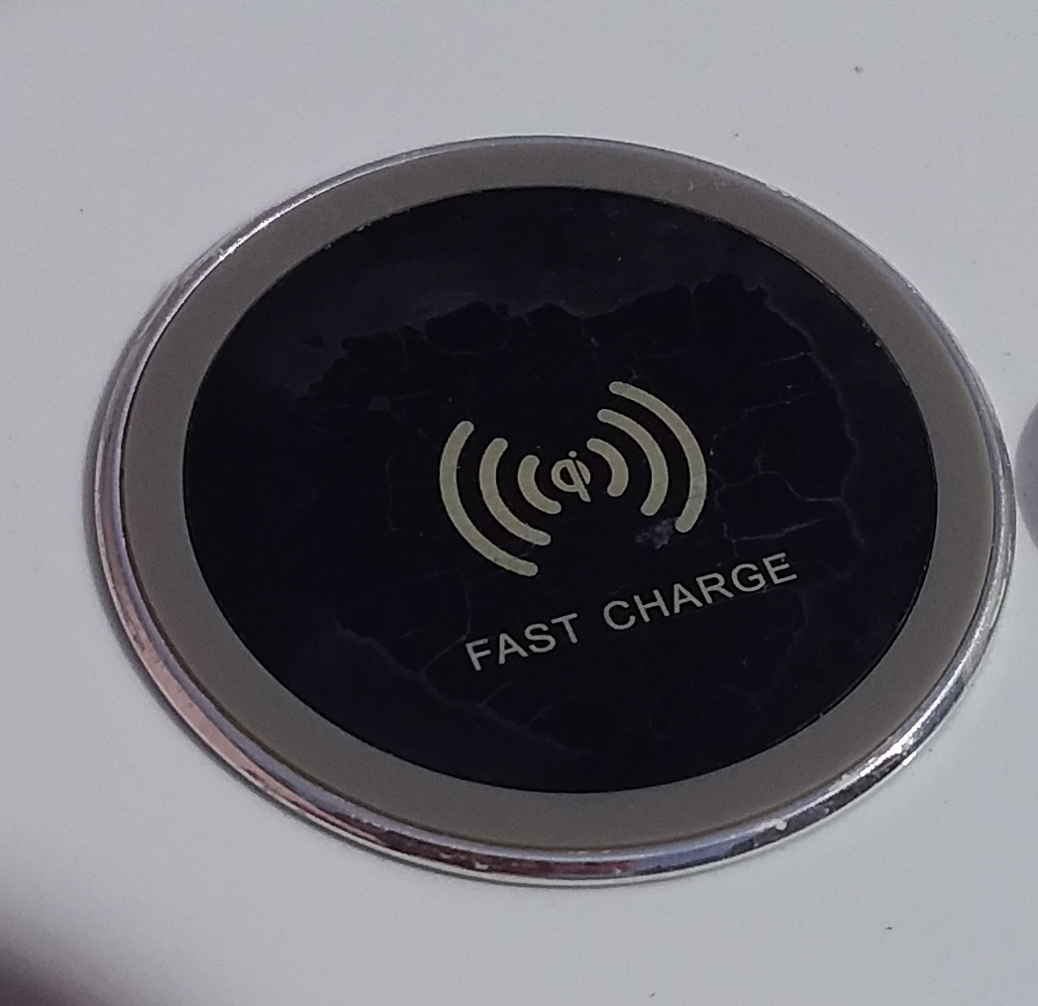
Technological comfort for spas Created by LIFEE

Slide 2
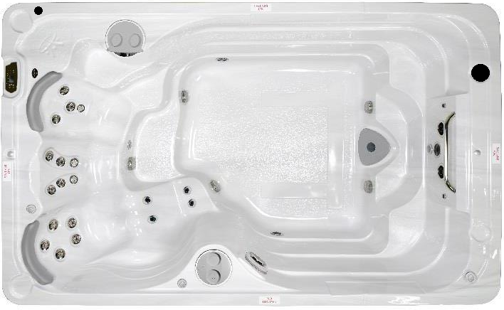
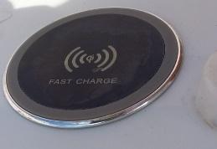
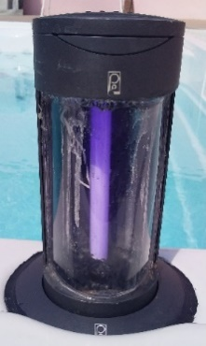
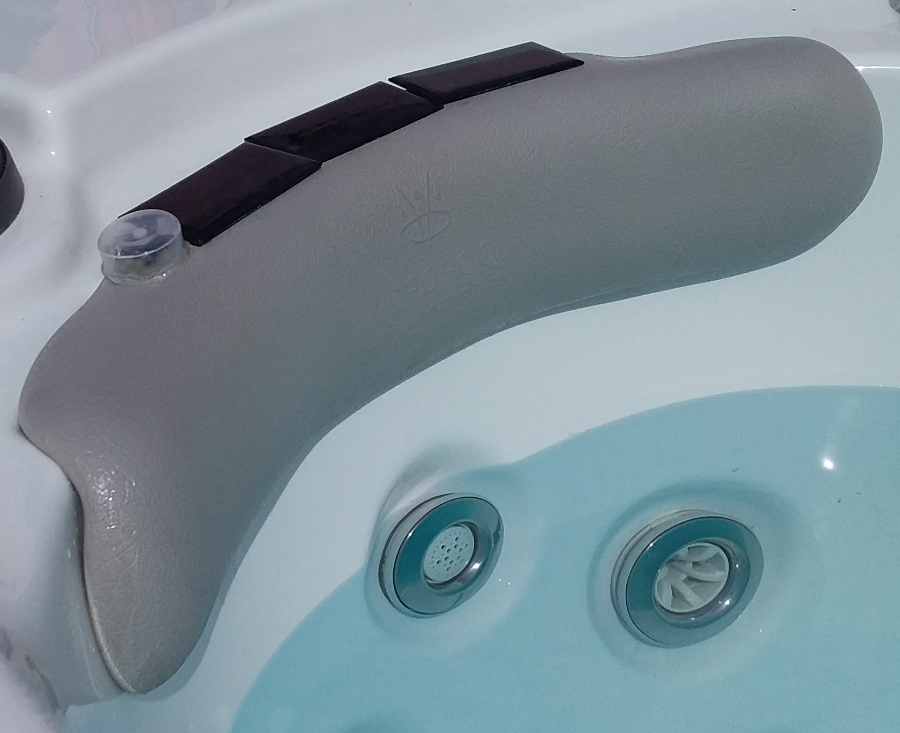
Overall diagram:
Wireless Charger
Insect repellent
Relaxing headrests
12FX Testing

Slide 3

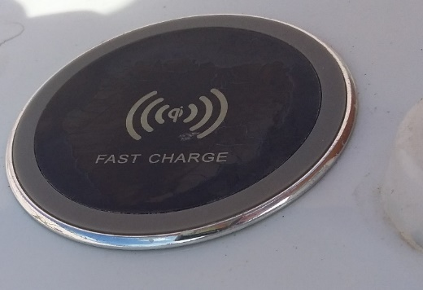
The Wireless Charger
This feature is for spas that offer the built-in music option with Bluetooth speakers.
Indeed, when the user uses his smartphone, it will discharge quickly, thus removing any possibility of managing the music at his convenience.
We have designed and integrated a waterproof wireless charger that is non-slip on the edge away from water. The user puts his smartphone on it and it recharges automatically.

Slide 4
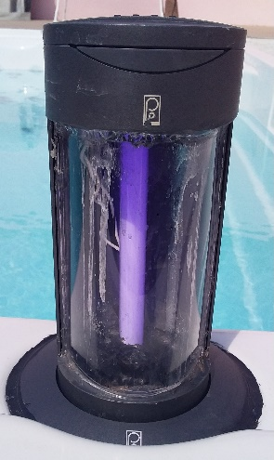
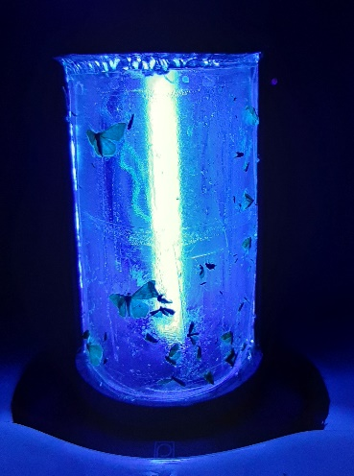
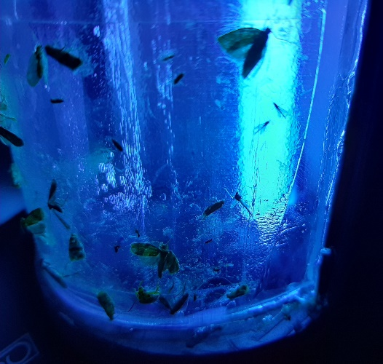
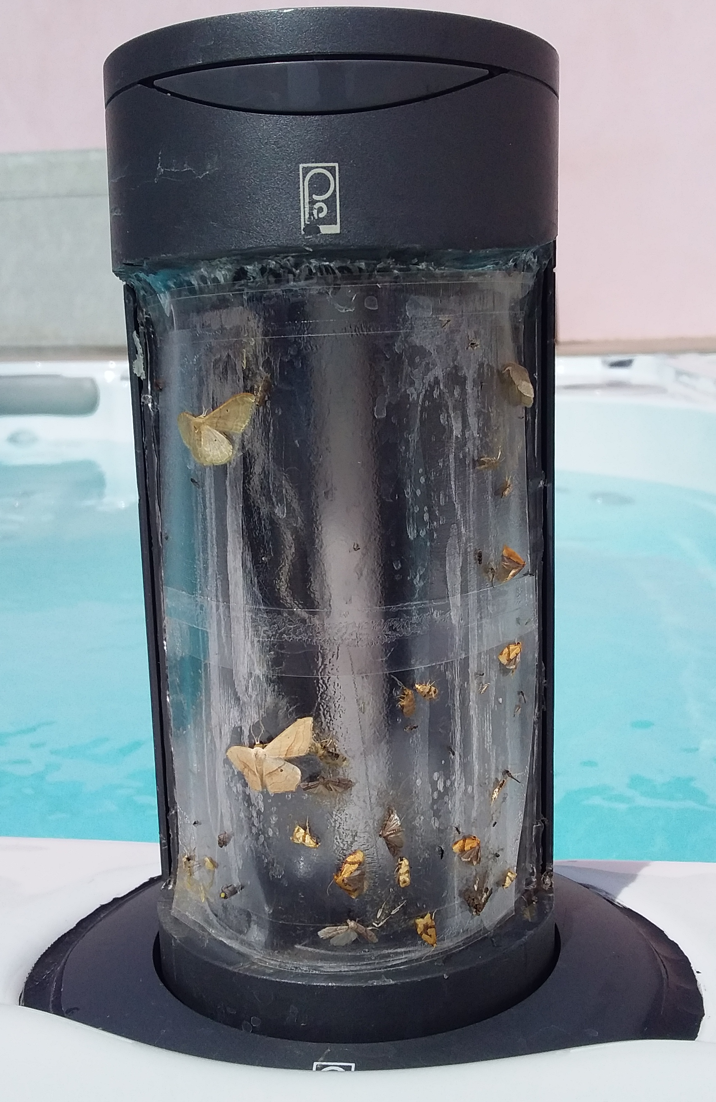
Mosquito repellent
What's more horrible than insects in the evening?
Our engineers have looked into the subject and we have developed an insect repellent system that complies with safety and waterproofing standards.
Perfectly integrated into the Spa, our solution keeps insects away and lets you enjoy your Spa in complete peace of mind.

Slide 5

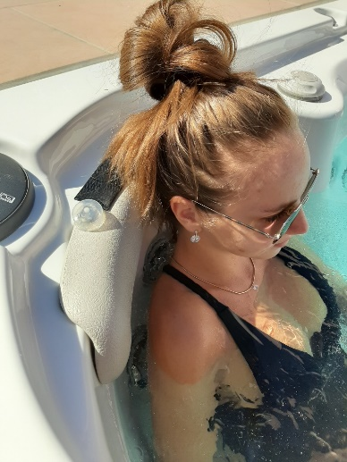
Relaxing headrests
These headrests allow you to massage the neck by making vibrations.
The solar panels recharge the battery, which helps to provide maximum autonomy and constant operation of the small motors.
Our engineers are already working on a version with several relaxing vibration modes.

Slide 6
Contact
Company: LIFEE
Director: Alexander Hoffmann
Email : info@lifee.ai
Port. : 06 11 30 11 61
Landline: 04 30 17 57 15
Address: 20 rue Famille Carrausse - 34300 Agde

